Slide 1
Neural Networks
are powerful!
Should I trust you?

Slide 2
01
02
03
04
Neural Networks
How easy to break them
What can we do about that?
Conclusion

Slide 3
01
NEURAL NETWORKS

Slide 4
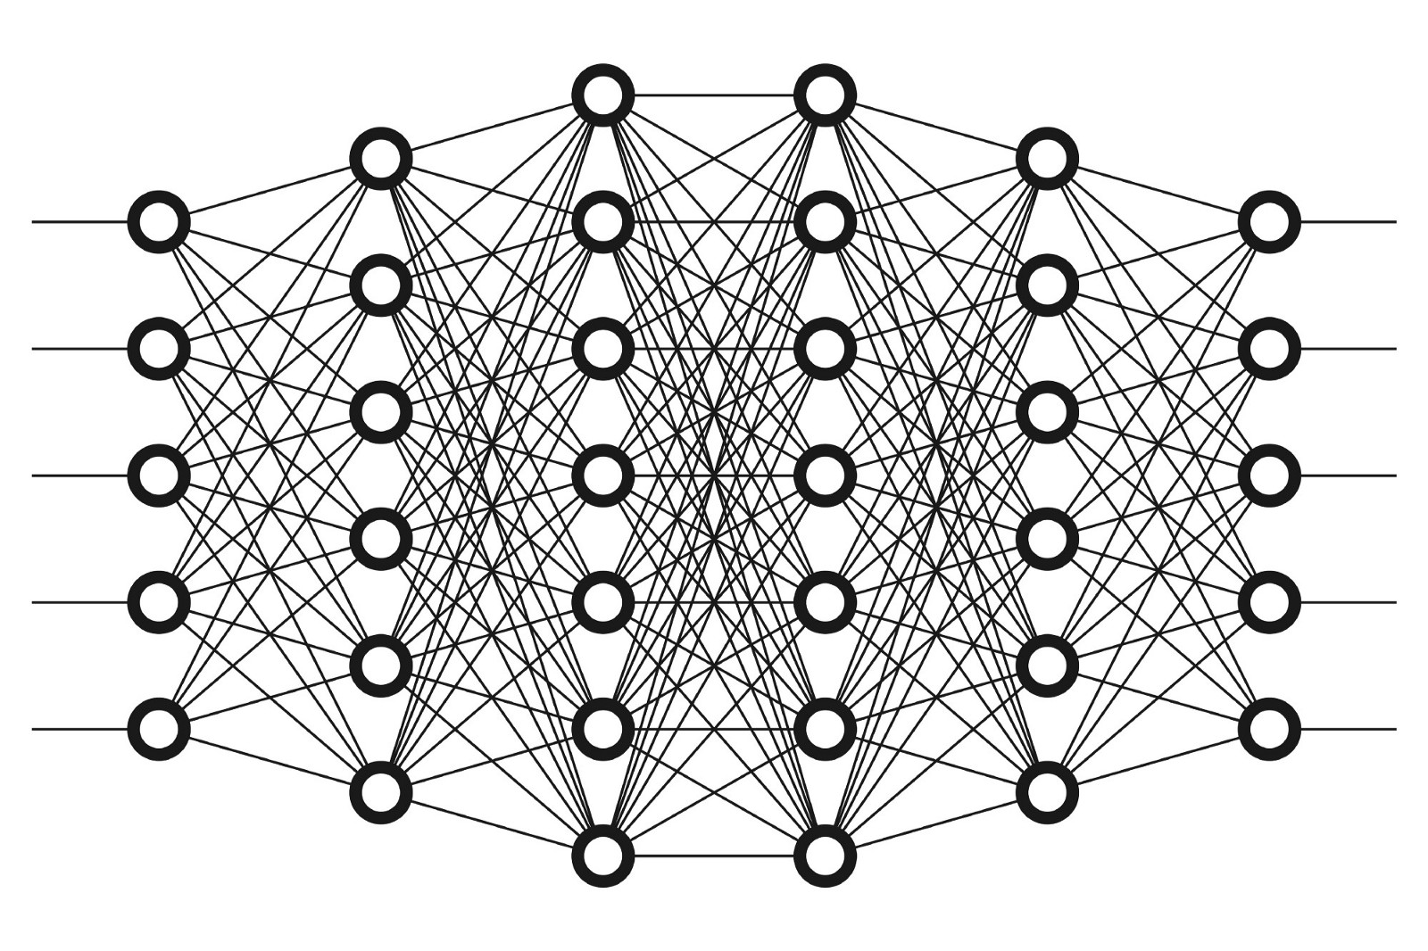
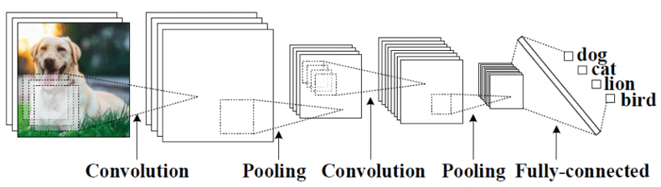
CONVOLUTION NEURAL NETWORKS
INTRODUCTION
Mercury is the closest planet to the Sun and the smallest one in the Solar System—it’s only a bit larger than the Moon. The planet’s name has nothing to do with the liquid metal, since Mercury was named after the Roman messenger god

Slide 5
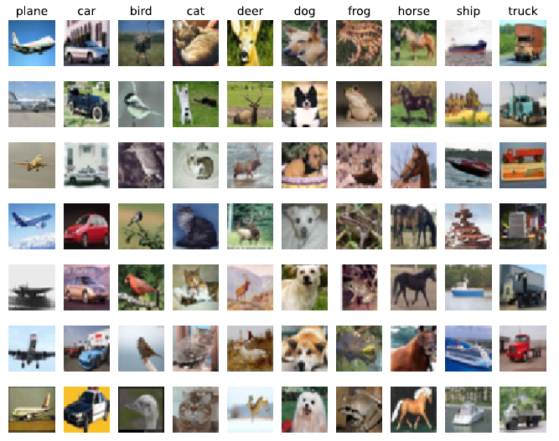
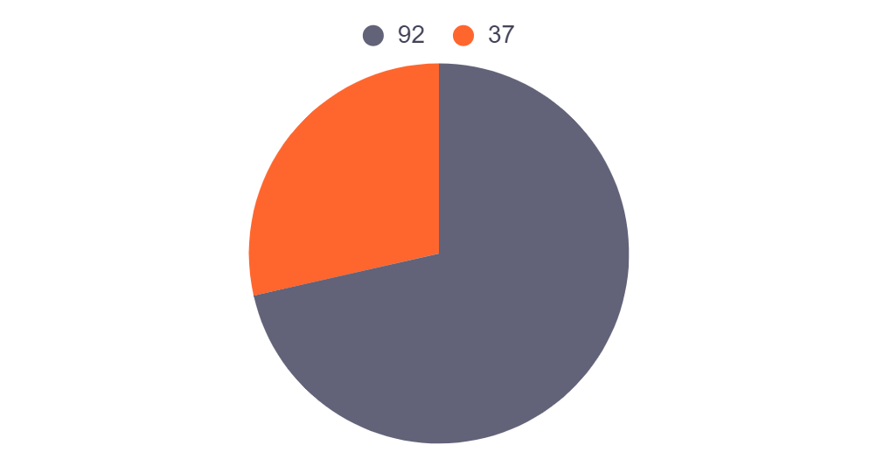
RESULTS ON CIFAR-10
SVM
RESNET
37%
92%
To modify this graph, click on it, follow the link, change the data and paste the resulting graph here

Slide 6
02
FOOLING NEURAL NETWORKS

Slide 7
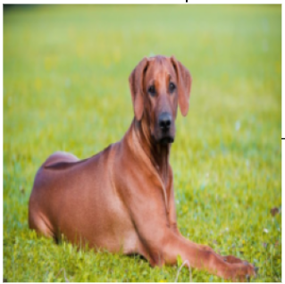
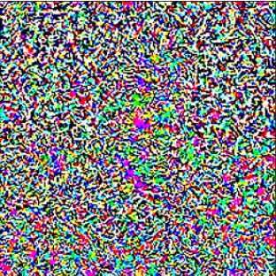
Adversarial examples
Rhodesian ridgeback
Perturbation
Sport car
99.98%
94.38%

Slide 8


Attack model with Projected gradient descent
FGSM
PGD

Slide 9
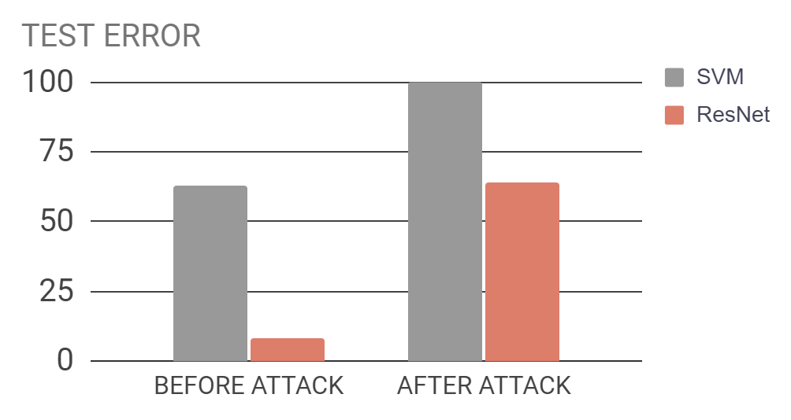
Attack model with Projected gradient descent
100%
63%
64%
8%

Slide 10
03
Training with adversarial examples

Slide 11

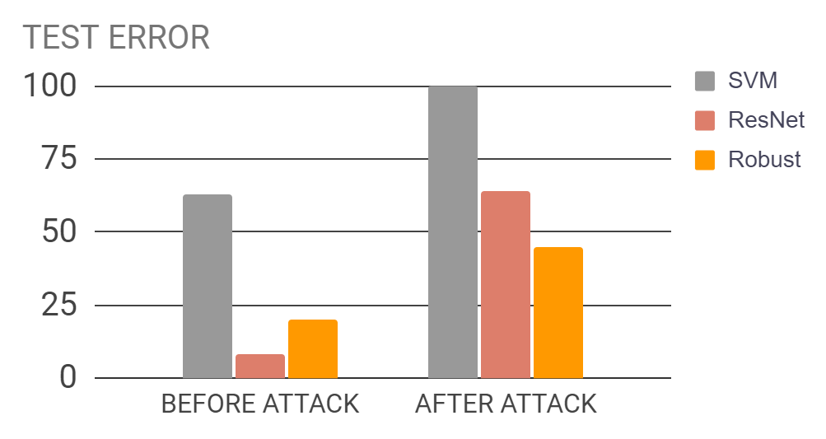
Attack model with Projected Gradient Descent
45%
20%

Slide 12
03
Conclusion

Slide 13
Conclusion
Neural networks
The power of NN in image classification
Inconsistency of neural networks
Adversarial examples can break NN
Robust model
Using adversarial examples to enhance the robustness of NN

Slide 14

THANKS

Slide 15
BIBLIOGRAPHICAL REFERENCES
● Dimitris Tsipras et. al. Robustness may be at odds with accuracy. 2019.
● Ian J Goodfellow, et. al. Explaining and harnessing adversarial examples. 2015.
● Szegedy, Christian, et. al. Intriguing properties of neural networks. 2014.
● Aleksander Madry, et al. Towards Deep Learning Models Resistant to Adversarial Attacks. 2017

